Slide 1
START

Slide 2
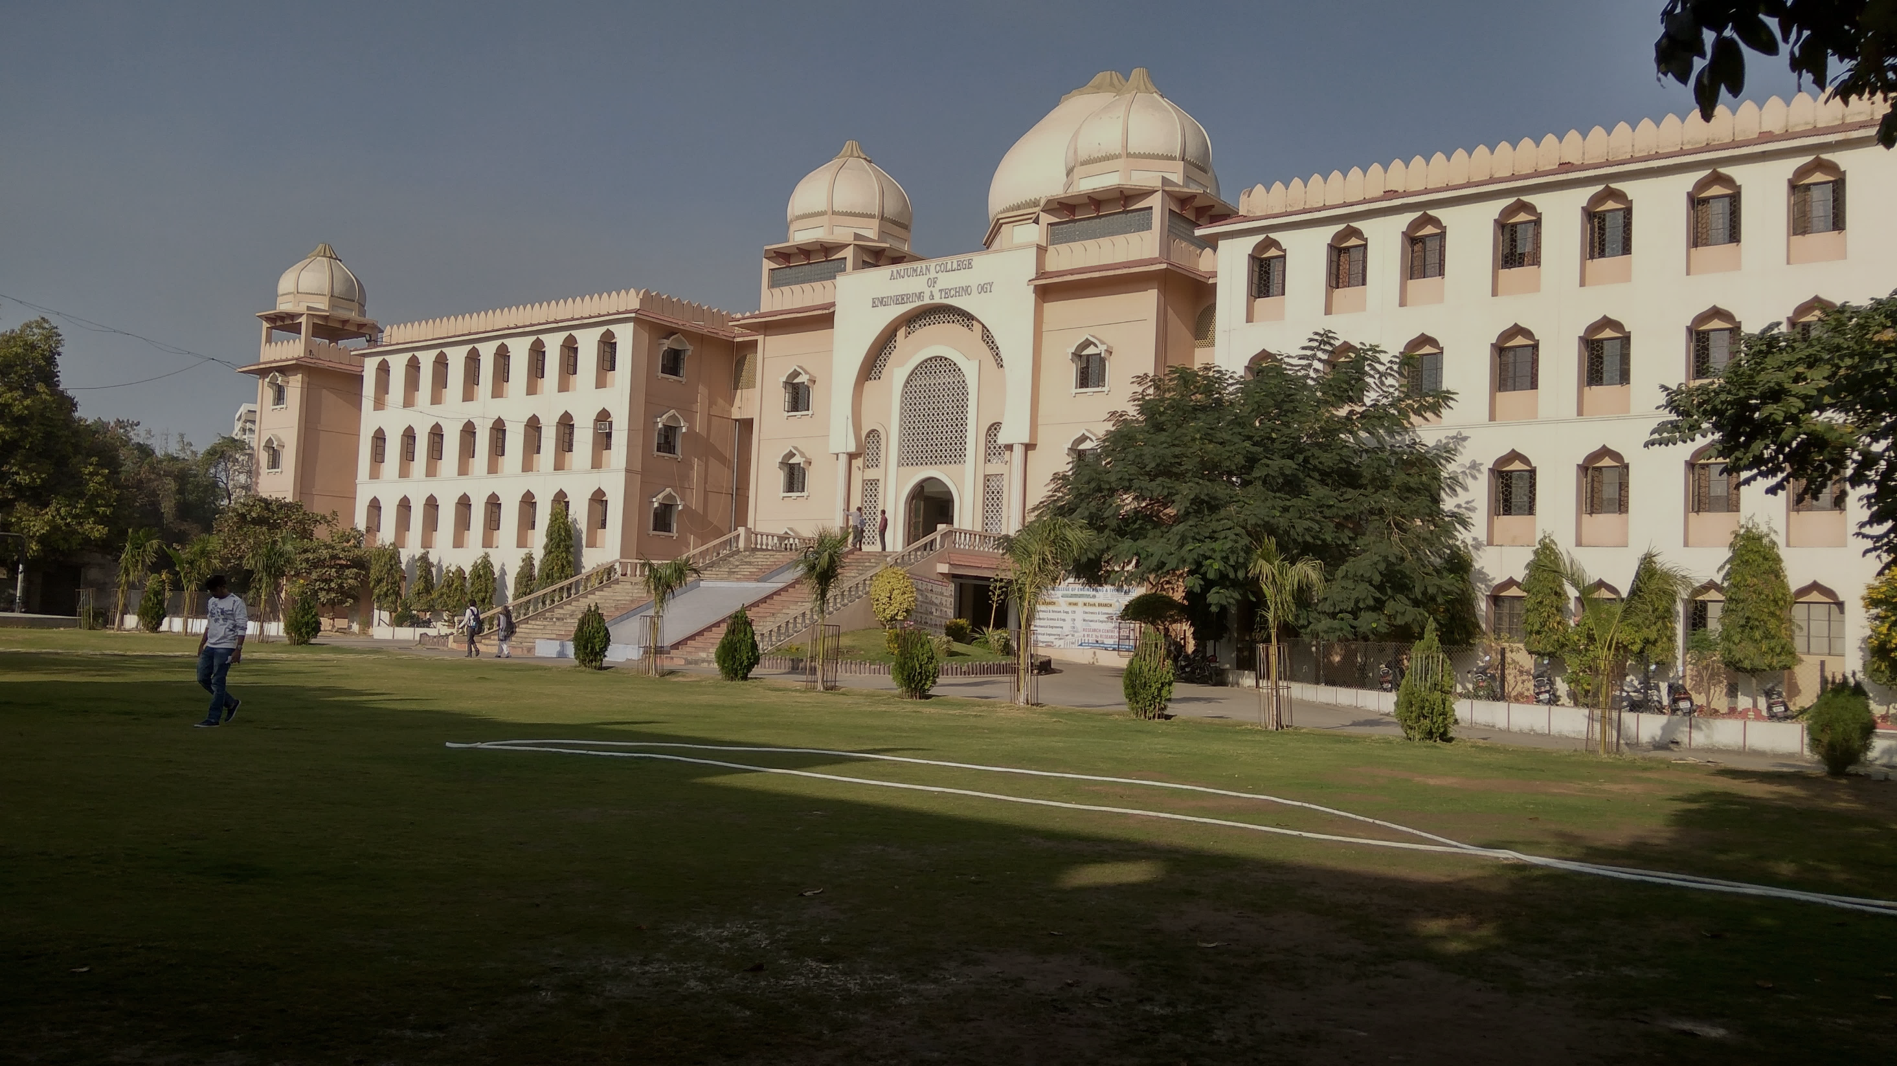
ANJUMAN COLLEGE OF ENGINEERING AND TECHNOLOGY
ENGINEERING MECHANICS
PROF. ASIM EJAZ SHEIKH
www.asimsheikh123.wordpress.com

Slide 3
Contents
FORCE
Characteristic of a Force
Type of Force
TYPES OF FORCE SYSTEM
RESULTANT OF FORCE SYSTEM :
Resultant of Concurrent Forces
Resultant of Non-Concurrent Forces
MOMENT OF A FORCES:
Moment of Coplanar Forces
Moment of a Force about a Point and an Axis

Slide 4
FORCE
An agent which produces or tends to produce , destroy or tends to destroy motion of a body is called force.
Unit of force is Newton.
It is a vector quantity.

Slide 5
CHARACHTERISTIC OF A FORCE
MAGNITUDE: Magnitude of force may be 10kn etc.
DIRECTION: It has certain fixed direction.
NATURE: It may be tensile or compressive.
POINT OF APPLICATION: Point at which force acts.

Slide 6
TYPES OF FORCES
Contact Force
Body Force
Point Force
Distributed Force
External Force
Internal Force
Frictional Force
Wind Force
Hydrostatic Force
Cohesive & Adhesive Force etc.

Slide 7
CONTACT FORCES
Force produced by direct contact of bodies is known as contact force.
It may be of pull type or push type.

Slide 8
BODY FORCES
Forces produced without contact of the bodies is called body force.
It is the force holds together the particles forming the rigid bodies.

Slide 9
POINT FORCES
Force acting at a point is called point force.
It acts on a very small area, compared to total surface area.

Slide 10
DISTRIBUTED FORCE
When force is distributed over large area it is called distributed force.

Slide 11
EXTERNAL & INTERNAL FORCE
The force exerted by weight on a body is external force, while the resistance offered to retain its shape is called internal force.

Slide 12
ACTION & RECTION
As per Newton’s third law, whenever a body exerts force (action) on other body. The other body exerts similar force on the former body known as reaction.
Action= Reaction

Slide 13
FRICTIONAL FORCE
Resisting force offered during sliding of a body by the surface in contact is called frictoinal forces.

Slide 14
WIND FORCE
Force exerted by wind when it is obstructed by any object.

Slide 15
COHESION & ADHESION
Force developed between molecules of same material is called cohesive forces.
Force developed between molecules of different materials is called adhesive force.

Slide 16
HYDROSTATIC FORCE
Force exerted by water on a body when it is obstructed by a body.

Slide 17
SYSTEM OF FORCES
When two or more forces act on a body, they are called to form a system of forces.
Coplanar Forces
Concurrent Forces
Collinear Forces
Coplanar Concurrent Forces
Coplanar non Concurrent Forces
Non coplanar Concurrent Forces
Non coplanar Non concurrent Forces
Like parallel Forces
Unlike parallel Forces
Spatial Forces

Slide 18
COPLANAR FORCES
Forces whose line of action lie on the same plane, are known as coplanar forces.

Slide 19
CONCURRENT FORCES
The forces which meet at one point, are known as concurrent forces.

Slide 20
CO-LINEAR FORCES
The forces whose line of action lie on the same line, are known as collinear force.

Slide 21
COPLANARn CONCURRENT FORCES
Forces which meet at one point & lines of action also lie on the same plane are known as coplanar concurrent forces.

Slide 22
NON-COPLANAR CONCURRENT FORCES
Forces whose line of action do not lie on the same plane, but they meet at one point.

Slide 23
COPLANAR NON-CONCURRENT FORCES
The forces whose line of action lie on the same plane but they do not meet at one point are known as coplanar non-concurrent forces.

Slide 24
NON-COPLANAR
NON-CONCURRENT FORCES
Forces whose line of action do not lie on the same plane & they do not meet at any point.

Slide 25
LIKE PARALLEL FORCES
Forces whose line of action are parallel to each other & all of them act in same direction.

Slide 26
UNLIKE PARALLEL FORCES
Forces whose line of action are parallel to each other but all of them do not act in the same direction.

Slide 27
SPATIAL FORCES
Forces acting in the space are known as spatial forces.
Forces acting in space but meeting at one point are known as spatial concurrent forces.

Slide 28
RESOLVED FORCES
Spliting of forces into their component unit is called resolution of forces.
This is the reverse process which consist of expressing a single force in terms of their components.

Slide 29
Example
y
6 N
5 N
x
35°
50°
30 N
20 N
X = 20 cos 35 – 30 sin 50 – 5 =
- 11.5983
Y = 6 – 20 sin 35 – 30 cos 50 =
- 24.7552
θ
R =
_{X} 2
+ Y ² = 27.3 N
tan^{−1 ⎛ Y ⎞} = 64.9°
θ =
⎜ _{X} ⎟
⎝ ⎠

Slide 30
FUNDAMENTAL PRINCIPLE OF MECHANICS
Principle of transmissibility
Principle of superposition
Law of gravitation
Law of parallelogram of forces

Slide 31
The Principle oF Transmissibility
F
F
If we concerns only about the
external resultant effects on rigid
?
=
body.
We can slide the force along its line of action.
(force can be considered as sliding
vector)
“A force may be applied at any point on its given line of action without altering the resultant effects external to the rigid body on which it acts.”

Slide 32
PARALLELOGRAM LAW OF FORCES
If two forces acting simultaneously on a particle, be represented in magnitude & direction by the two adjacent sides of a parallelogram: their resultant may be represented in magnitude & direction by the diagonal of the parallelogram which passes through the point of intersection.

Slide 33
RESULTANT OF FORCE SYSTEM
1. Resultant of Concurrent Forces:
The resultant of a concurrent force system can be defined as the simplest single force which can replace the original system without changing its external effect on a rigid body.
2. Resultant of Non-Concurrent Forces:
The resultant will not necessarily be a single force but a force
system comprising a force or a couple or a force and a couple.

Slide 34
RESULTANT OF FORCE SYSTEM
Types of Force System

Slide 35
RESULTANT OF FORCE SYSTEM
Resultant of Concurrent Forces:
The resultant of a concurrent force system can be defined as the simplest single force which can replace the original system without changing its external effect on a rigid body.
Coplanar Concurrent Force
Non-Coplanar Concurrent Force
Resultant of Non-Concurrent Forces:
The resultant will not necessarily be a single force but a force
system comprising a force or a couple or a force and a couple.
Coplanar Non-Concurrent Force
Non-Coplanar and Non-Concurrent Force

Slide 36
Resultant of Coplanar Concurrent Forces
Resultant of Coplanar Concurrent Forces:

Slide 37
Resultant of Coplanar Concurrent Forces
Example:
Four forces act on a body as shown in Figure. Determine the resultant of the system of forces.

Slide 38
Resultant of Coplanar Concurrent Forces
Solution

Slide 39
Resultant of Coplanar Concurrent Forces

Slide 40
Resultant of Non-Coplanar Concurrent Forces
Resultant of Coplanar Concurrent Forces:
If three non-coplanar forces F1, F2 & F3 are acting at a point 0 in a body, the resultant R12 of the two forces F, and F2 can be determined by law of parallelogram of forces.
Thus, the vector sum of a non-coplanar system of concurrent forces F1, F2 and F3 is given by:

Slide 41
Resultant of Non-Coplanar Concurrent Forces

Slide 42
Resultant of Coplanar Non Concurrent Forces
Resultant of Coplanar Non-Concurrent Forces:
Obtained by adding two forces at a time and then combining their sums. The three forces Fl, F2 and F3 shown in Figure 1.26 may be combined by first adding any two forces such as F2 and F3. They may be moved along their lines of action to their point of concurrency A by the principle of transmissibility.

Slide 43
Resultant of Coplanar Non-Concurrent Forces
Their sum R1 is formed by the law of parallelogram of forces.
The force R1 may then be combined with F1 by the parallelogram law at their point of concurrency B to obtain the resultant R of the three given forces.
Here, the order of combination of the forces is immaterial as may be verified by combining them in a different sequence.
Now, the force R may be applied at any point on its established line of action.

Slide 44
Resultant of Non Coplanar Non Concurrent Forces
Resultant of Non-Coplanar and Non- Concurrent Forces:
The resultant of a non-parallel, non-coplanar, non- concurrent force system can be a single force or a couple.
The resultant is a force when ∑F is different from zero and a couple when ∑F is equal to zero unless ∑M0 is also zero in which case the system is in equilibrium and the resultant is zero.

Slide 45
Resultant of Non-Coplanar Non Concurrent Forces
Now, the resultant couple is given by:
And the direction of the resultant couple may be specified by its direction cosines, which are

